Slide 1
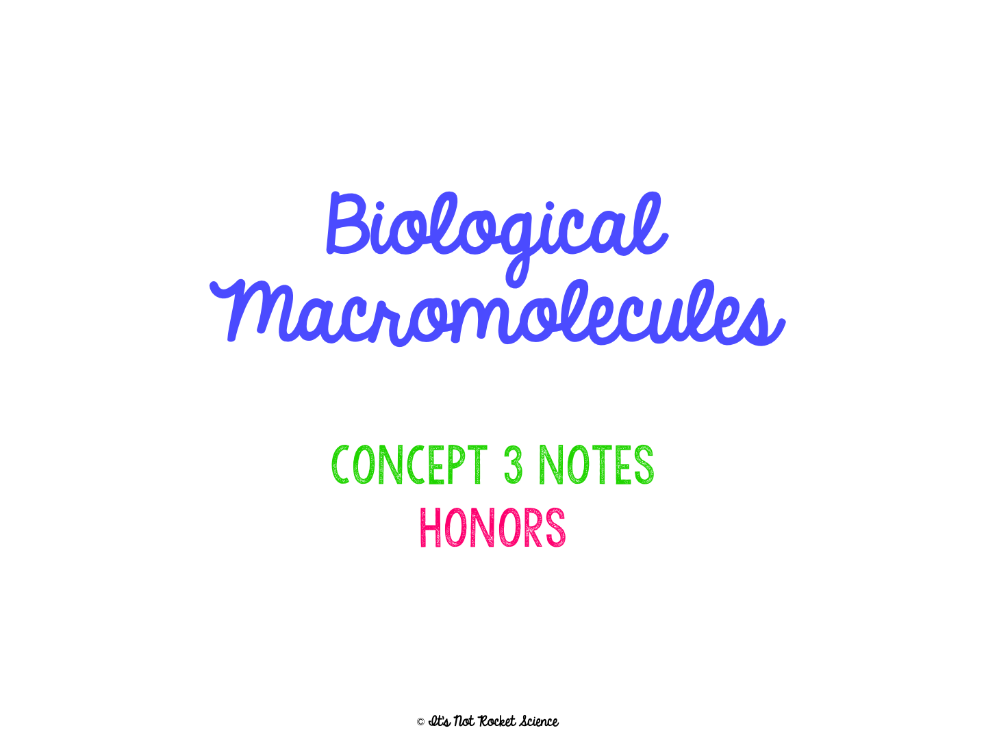

Slide 2
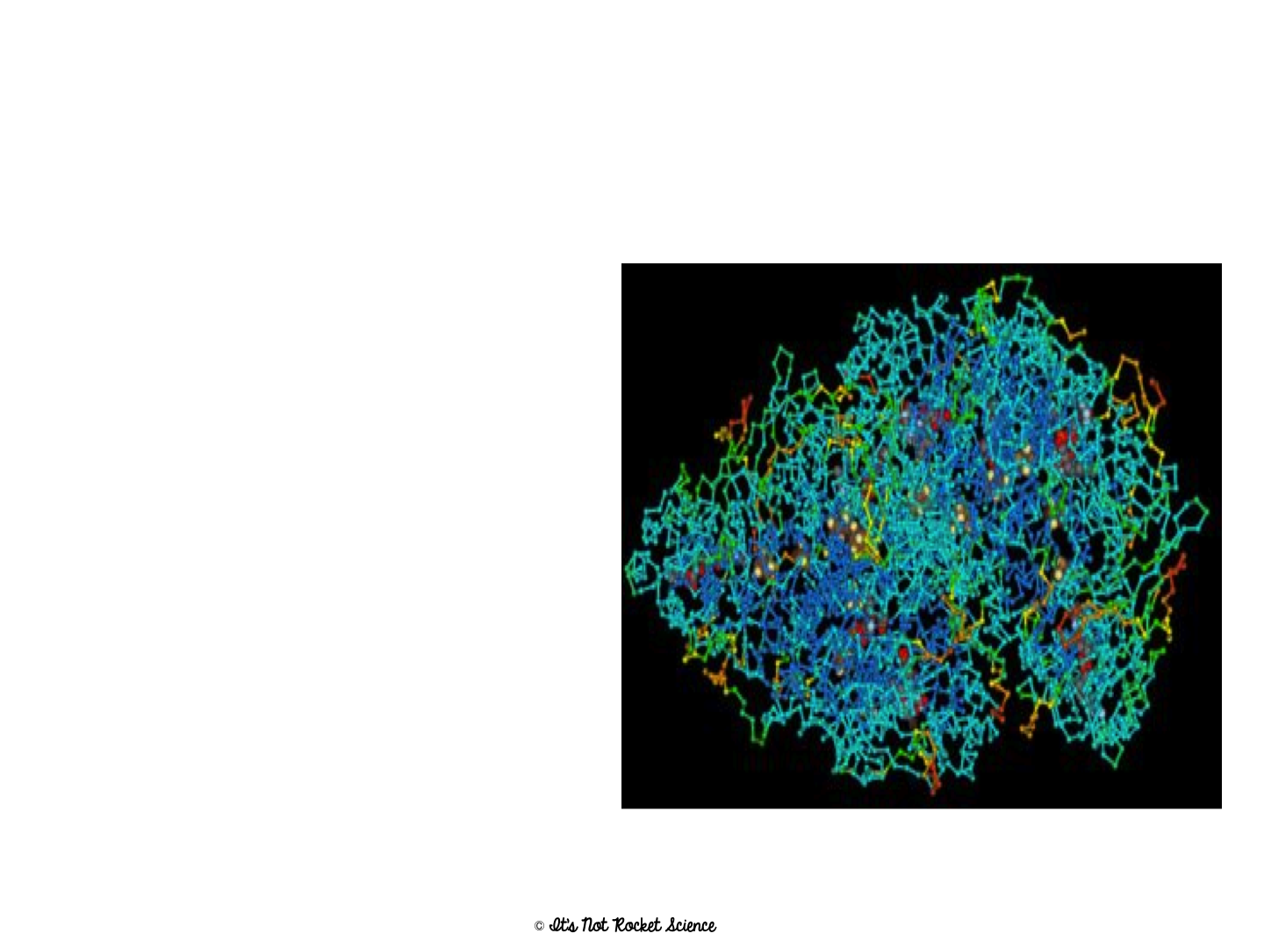
What are Macromolecules?
Many organic molecules are so large they are known as Macromolecules which means giant molecules.
We can’t live without them!!
  EVERYTHING we will learn for the rest of the semester will be based upon one of these macromolecules

Slide 3
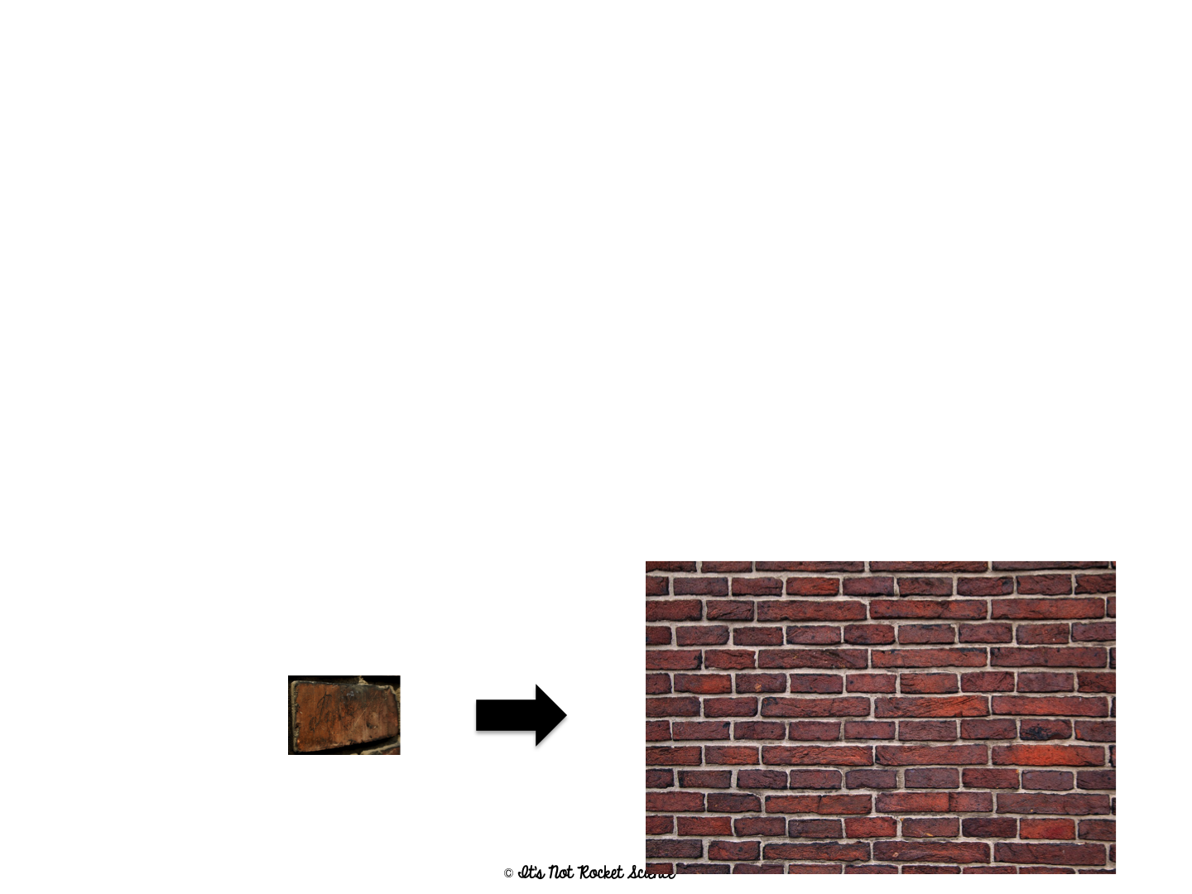
Monomers and Polymers
Most macromolecules are polymers, built of monomers joined through polymerization.
Smaller units called monomers are joined to make polymers through polymerization.
Monomers: small, basic unit (ex. think Brick)
  Monomers can be the same or unique
Polymers: complex structure made of monomers (ex. think Brick House)

Slide 4
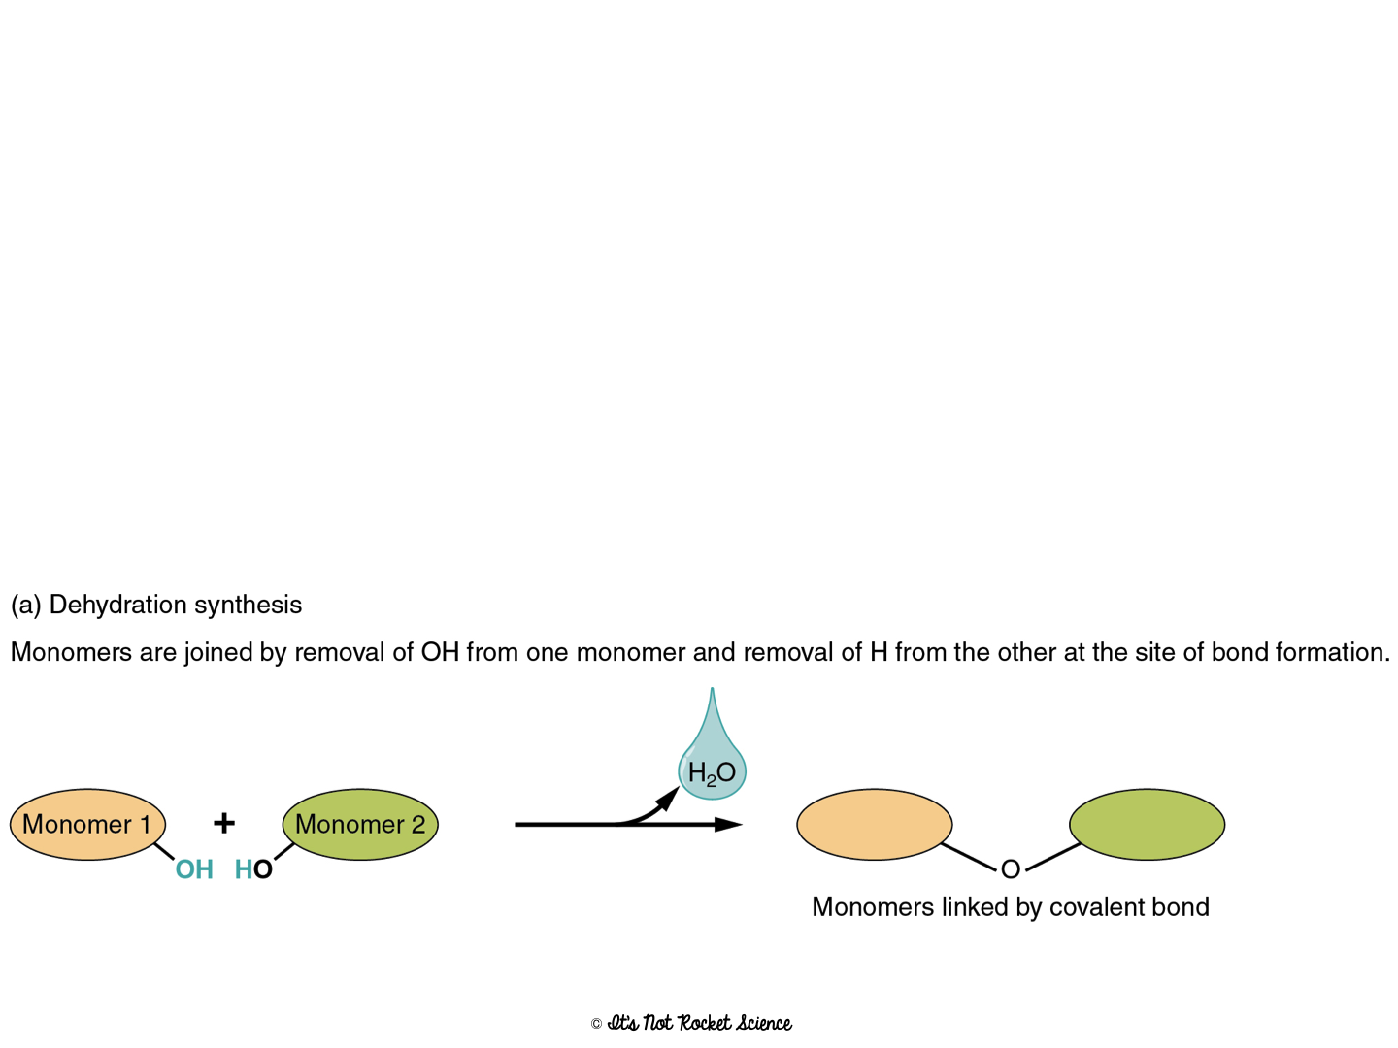
Building Polymers:
Dehydration Reaction
To build a polymer, we must link monomers
Building polymers is called a dehydration reaction when monomers unit.
  Example: 2 monosaccharides (glucose+ fructose) = 1 disaccharide (sucrose)
Removes a water molecule (gives off water)

Slide 5
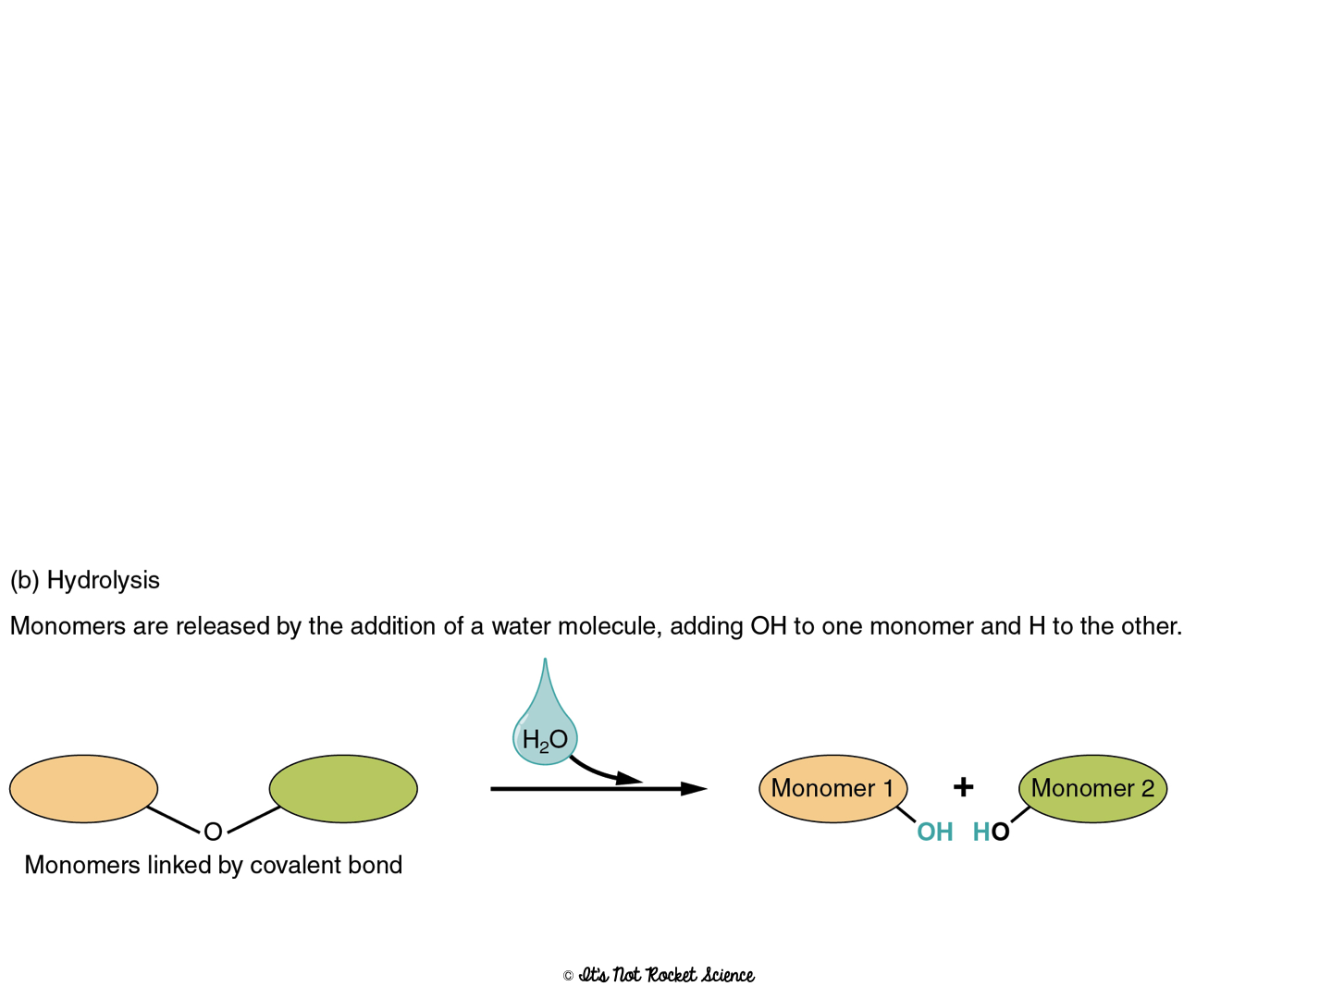
Breaking Polymers:
Hydrolysis
Breaking polymers is called a hydrolysis reaction
Opposite of Dehydration Reaction
Water is added– water forces its way in and breaks bonds
Breaks big polymers into monomers

Slide 6
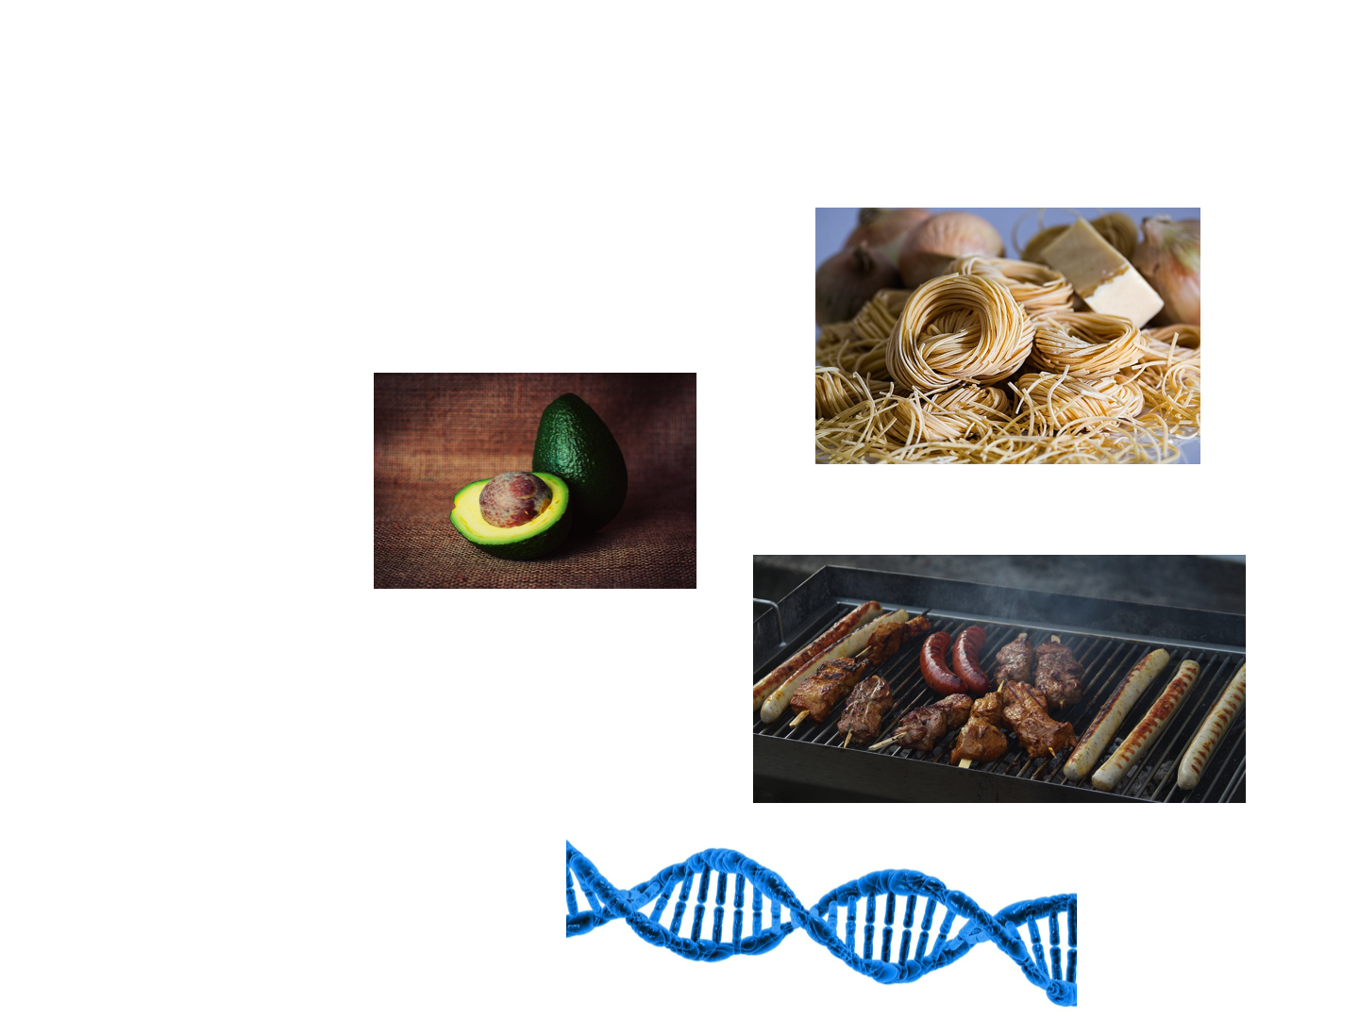
Types of Macromolecules:
Carbohydrates
Lipids
Proteins
Nucleic Acids

Slide 7
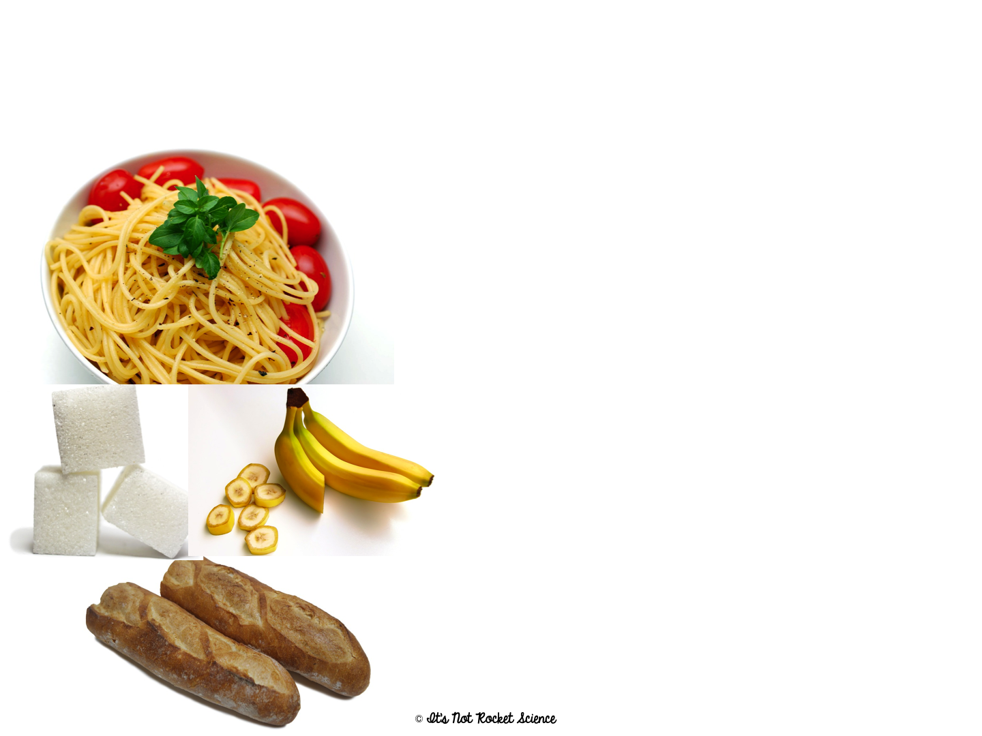
Carbohydratesare composed of Carbon, hydrogen and oxygen in a 1:2:1 ratio.
Main Function = short-term ENERGY
Other uses = structure/support
Found in: sugar and starch (therefore breads, pastas, fruits and veggies)
Made of: C, H, O in a 1:2:1 ratio

Slide 8
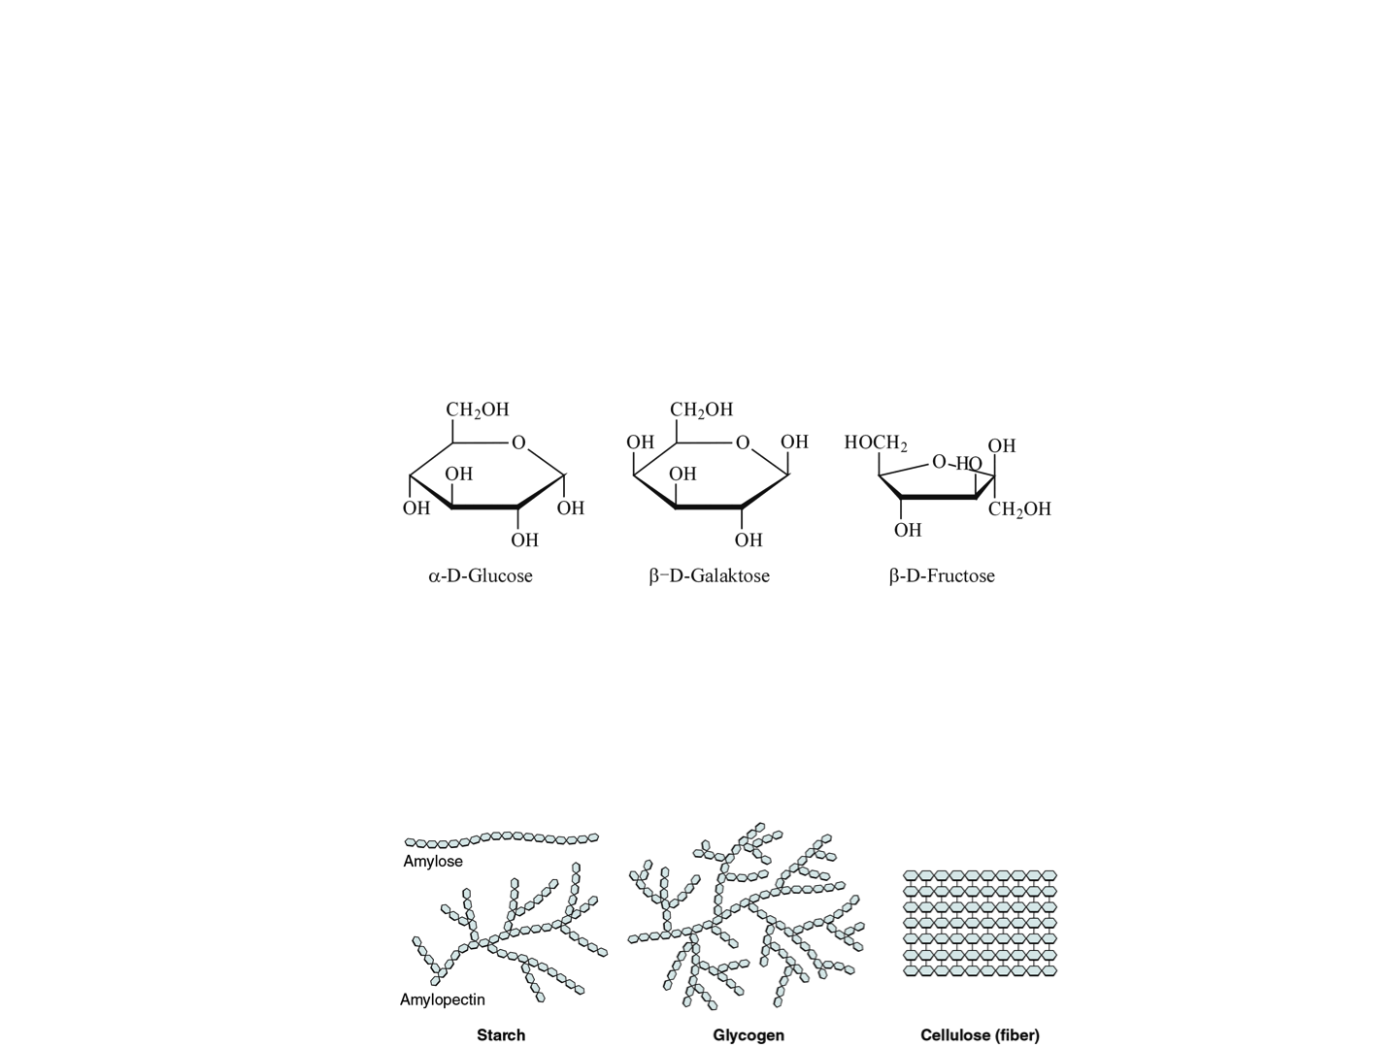
2 types of Carbohydrates:
a. Monomer = Monosaccharides – single sugar molecules
  Ex. Glucose (main fuel for cell), Galactose (milk), Fructose (fruit)
b. Polymer = Polysaccharides – large molecules formed by monosaccharides.
  Ex. Starch (how plants store sugar, grains), Glycogen (how animals store sugar), Cellulose (structural support in plant cell walls)

Slide 9
Energy Storage of Carbs
4 calories/milligram
Because it is short term energy, your body can access it very easily so it is the FIRST thing you will break down to get energy when you need it!

Slide 10
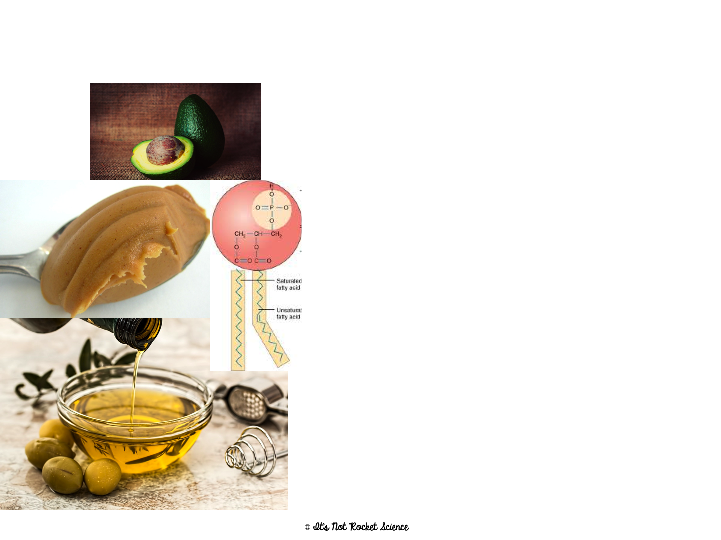
Lipids- NON SOLULBLE GROUP OF LARGE AND VARIED MOLECULES MADE OF CARBON AND HYDROGEN AND OXYGEN
Main Function= Long-term Energy Storage
Other uses = cushioning organs, insulation, hormones, cell membrane
Found in: Fats, oils, phospholipids (in the cell membrane), steroids
Made of: C, H, O

Slide 11
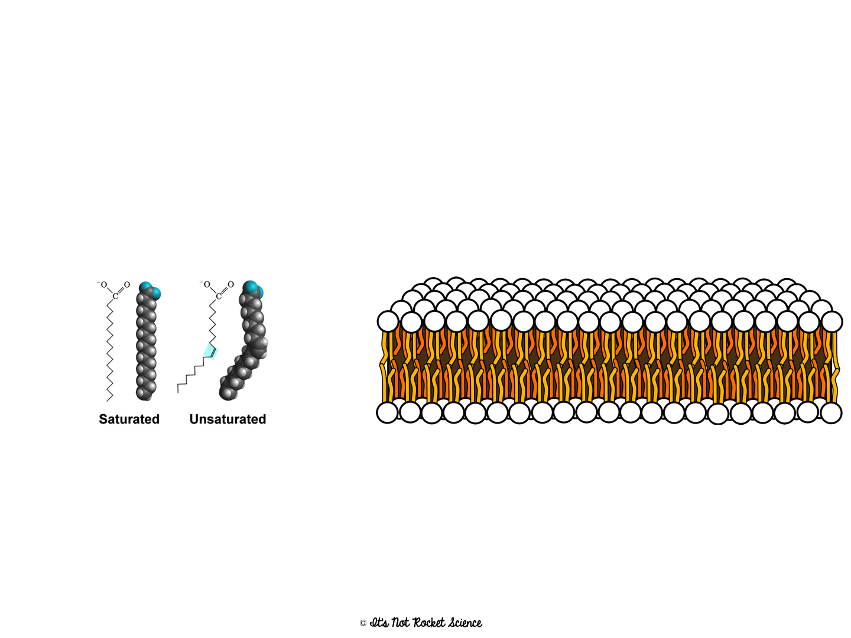
Lipids
Monomer = no “true” monomer, but mostly Fatty Acids
Polymer = fats, oils, phospholipids, steroids, hormones
Energy Storage = 9 calories/milligram
  When your body runs out of carbs, it will then break down lipids to get energy

Slide 12
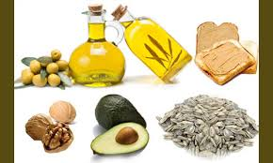
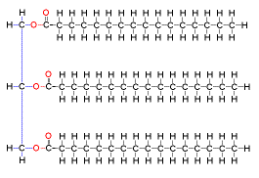
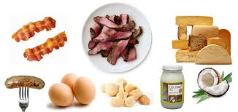
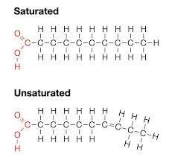
Lipids
Many formed when a glycerol molecule combines with compounds called fatty acids
Saturated- each carbon is bonded to another carbon by a single bond
  Max # of H
Unsaturated- at least on C-C double bond
  More than one=polyunsaturated
  Tend to be liquids at room temperature- olive soil, corn oil

Slide 13
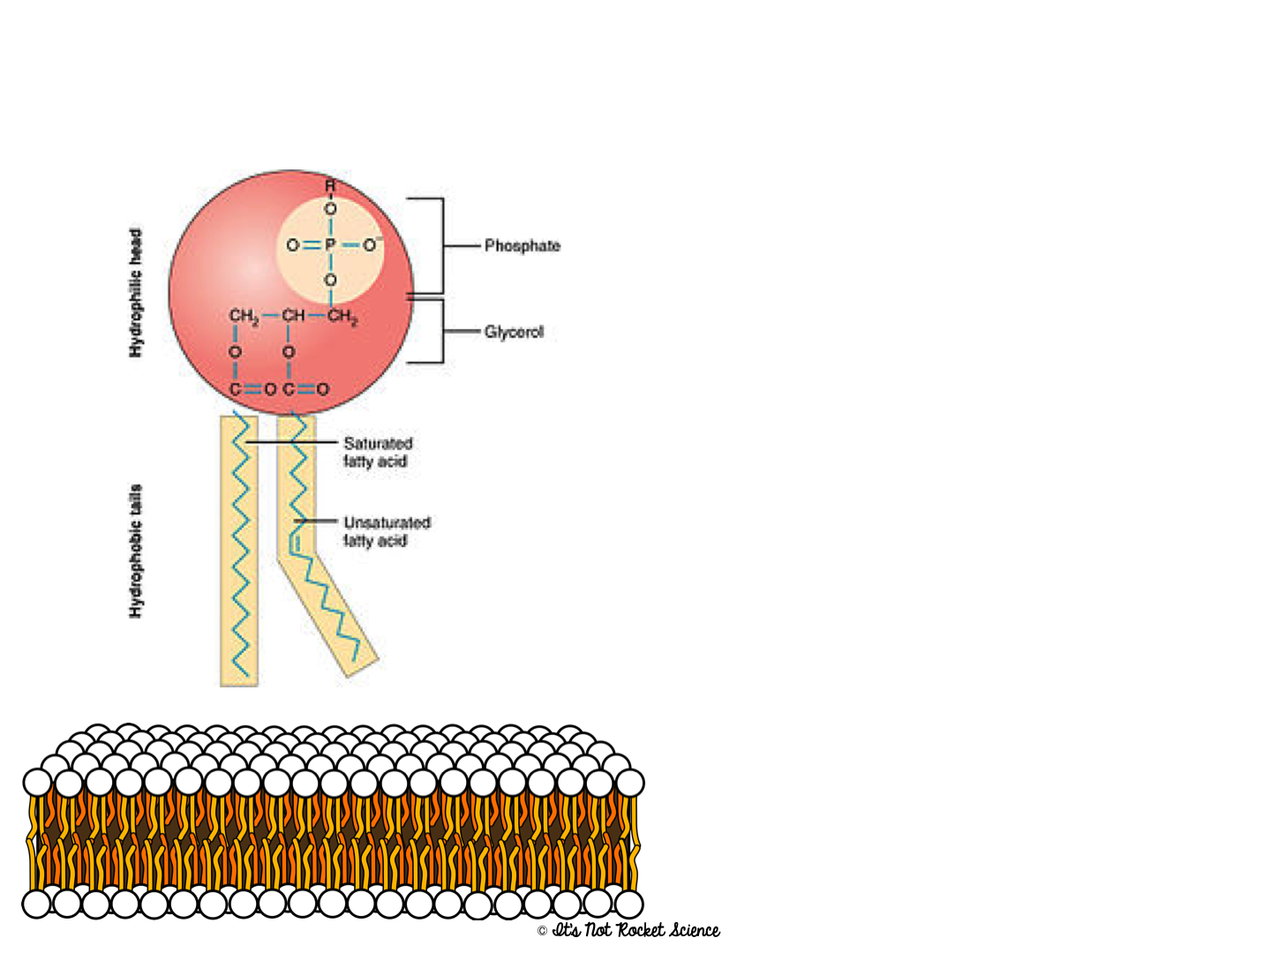
Phospholipids = a special lipid
Structure = 2 fatty acids, a phosphate and a glycerol
These molecules are found making up the plasma membrane of cells.
The phosphate group is hydrophilic while the fatty acid area is hydrophobic.

Slide 14
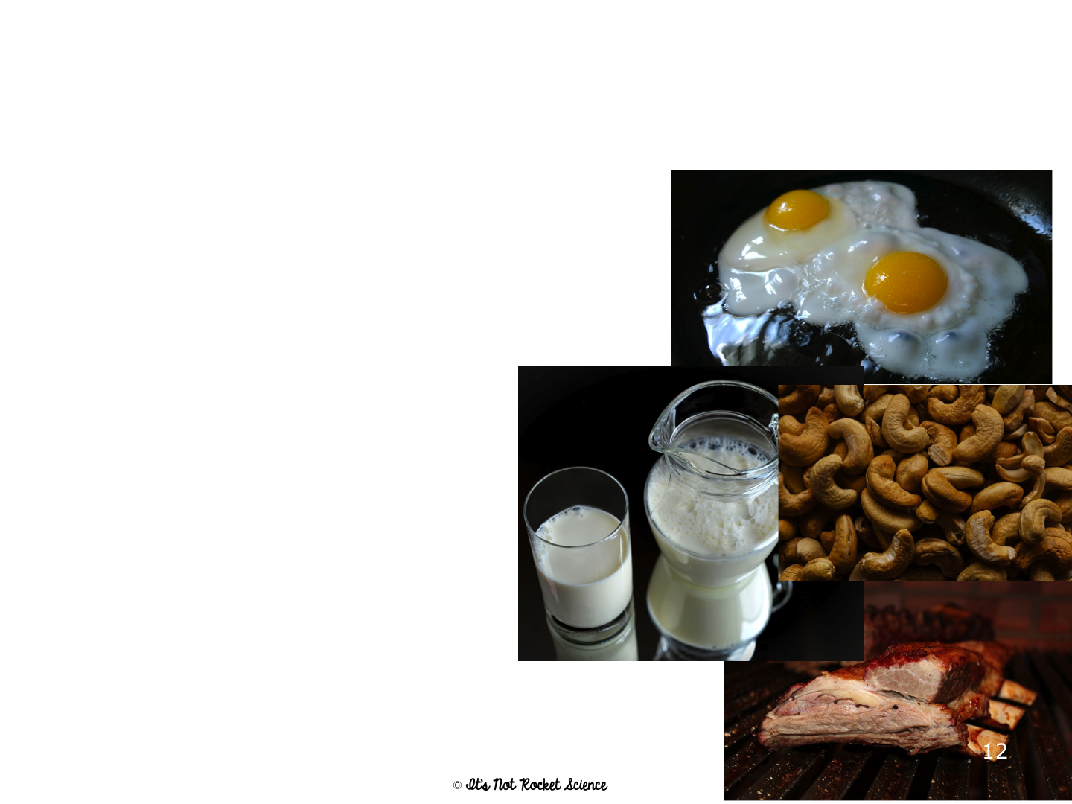
Proteins- CAN CONTAIN NITROGEN, SULFUR AND PHOSPHOROUS
Most diverse macromolecule
Most abundant macromolecule (make up 50% of cell’s biomass)
They literally RUN your body!!

Slide 15
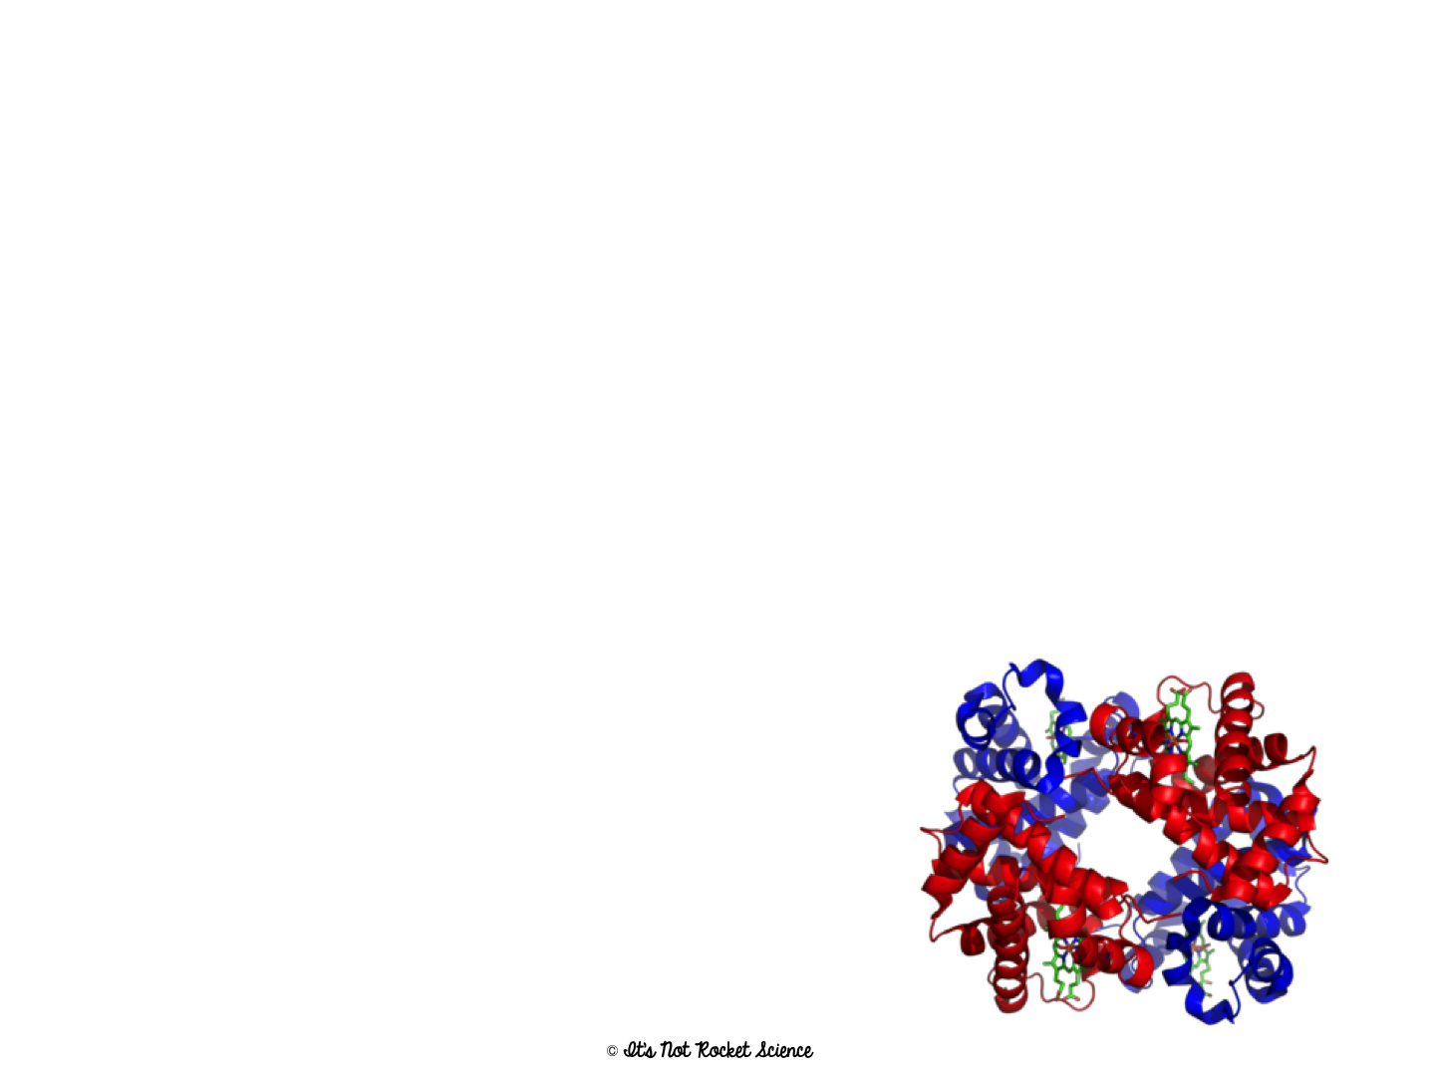
Functions of Proteins
1. Enzymes control the rate of chemical reactions
2. Hormones regulate cell processes (ex. Insulin)
3. Used to form bones and muscles (ex. Collagen)
4. Transports substances in & out of cells (ex. Hemoglobin)
5. Antibodies help fight diseases
6. Food source (Ex. Casein in milk)

Slide 16
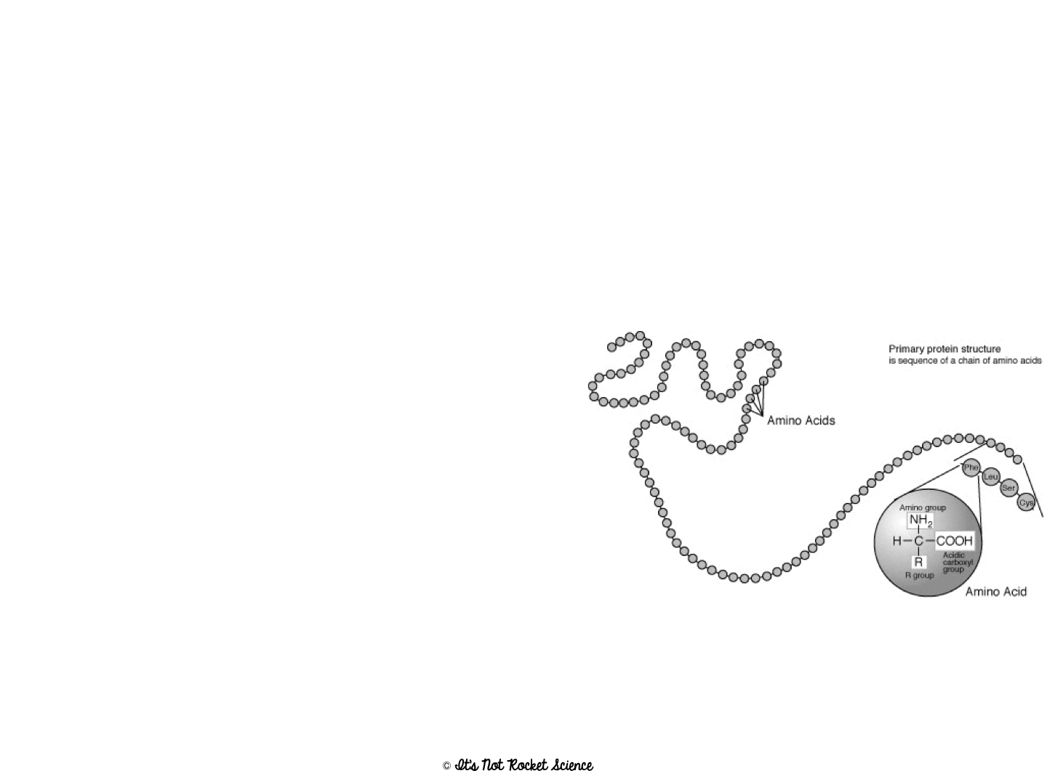
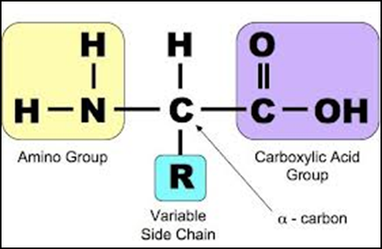
Proteins
Found in = meats, nuts, Greek yogurt, etc. Examples in your body include hemoglobin and insulin
Made of = C, H, O, N, P and S
Monomer = Amino Acids
Polymer = Polypeptide
(amino acids are linked
together by a peptide bond)
Energy Storage = 4 cal/mg
  Because they have so many other uses though, they are the LAST thing your body will break down if it needs energy

Slide 18
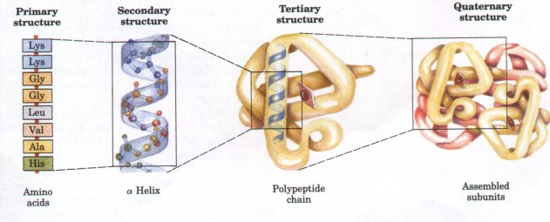
Proteins
4 levels of structure- coded in DNA
  Primary- sequence of amino acid
  Secondary- folding or coiling of the poly peptide chain
  Tertiary- complete 3D arrangement of a polypeptide chain
  Quaternary- more than one chain describing how different polypeptides are arranged with respect to one another
Shape is maintained by ionic and covalent bonds, van der Walls forces and hydrogen bonds

Slide 19
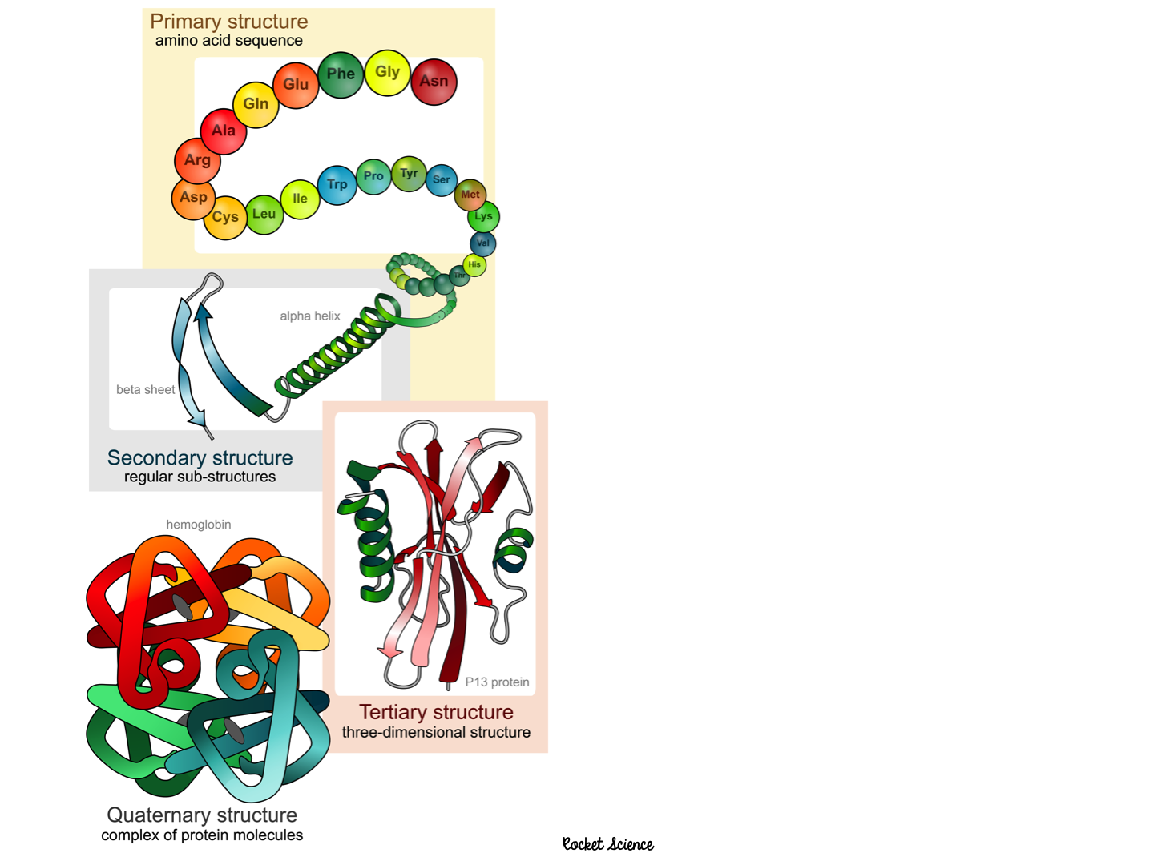
Importance of Folding:
Form dictates function
The shape of the protein determines what it does

Slide 20
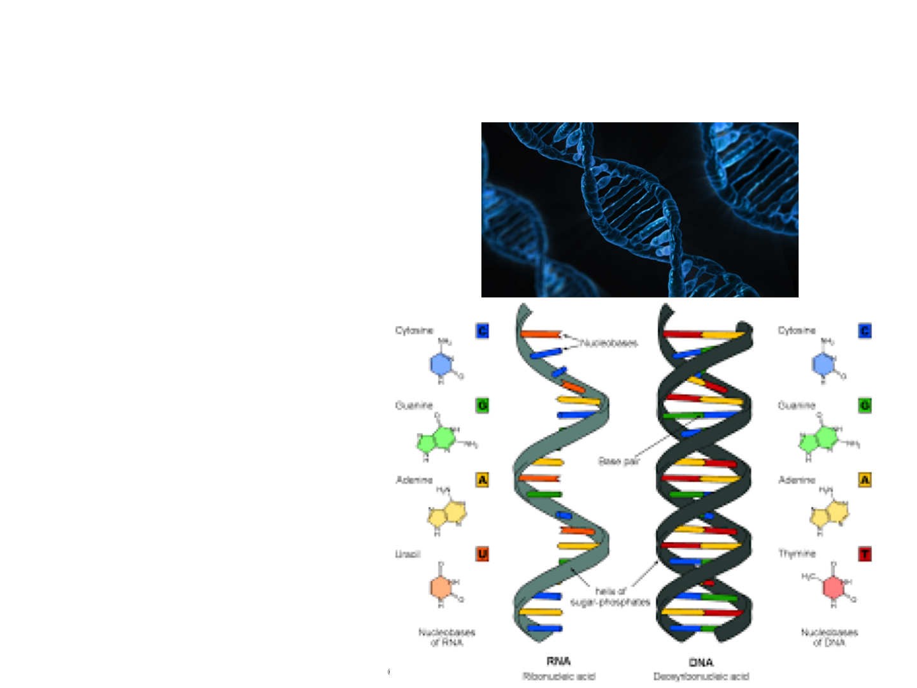
Nucleic Acids
Main Function: store & transmit hereditary or genetic information
  Ex. DNA, RNA
  You get them from your PARENTS not your food!
Made of: C, H, O, N, and P

Slide 21
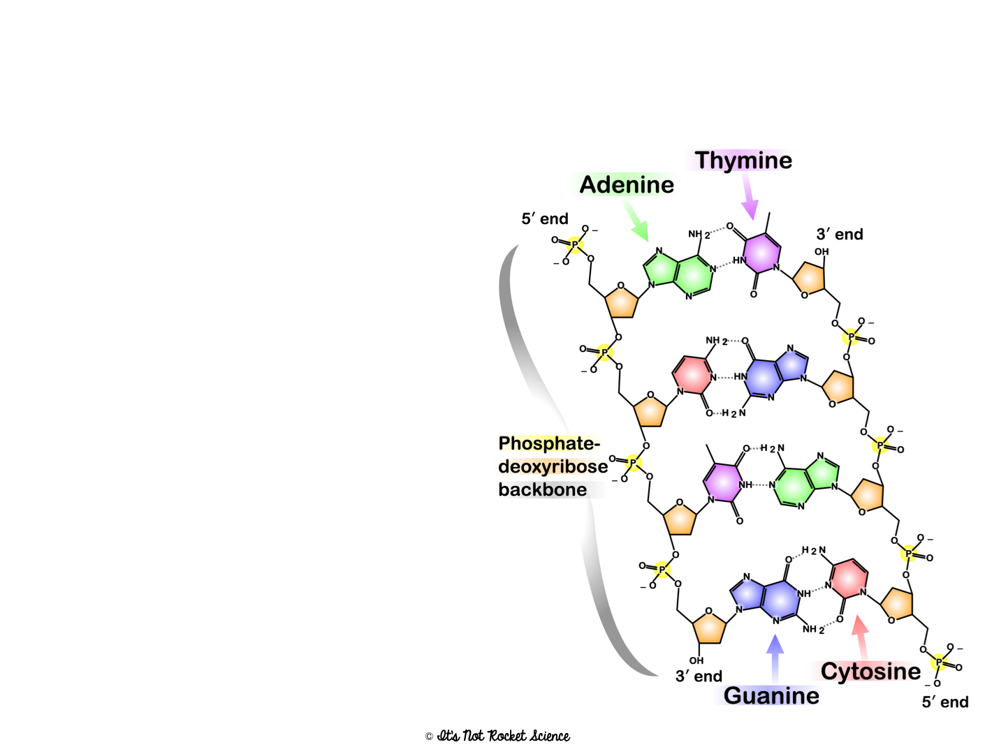
Nucleic Acids
Structure
Monomer = nucleotides
  Ex. A, G, T, C, U
    5-carbon sugar
    Phosphate group
    Nitrogenous base
Polymer = Nucleic Acid
  Ex. DNA and RNA

Slide 22
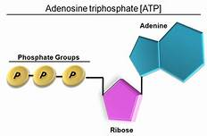
Adenosine Triphosphate- ATP
Nucleotide that captures and transfers chemical energy for cells
Has 3 phosphate groups!!!

Slide 23
Energy Storage of Nucleic Acids
0 cal/mg
  Nucleic Acids are NOT EVER broken down for energy!! They don’t even store any energy!!
Notes:
Great summary video to watch after is this Crash Course: https://www.youtube.com/watch?v=H8WJ2KENlK0

Slide 24
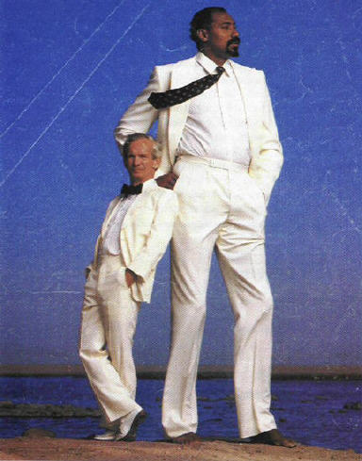
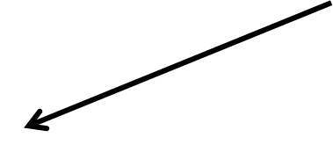
Structure and Function
Will Chamberlain- 7 ’11”
Willie Shoemaker- 4’11”
How does the structure of these men relate to what they do?
The same is true for macromolecules!

Slide 25
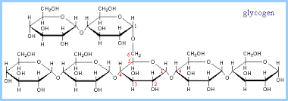
Why wouldn’t the carbohydrate pictured by a good choice for transmitting and storing genetic information?
Not enough variety in monomers to encode heredity
But this simple molecule is GREAT at storing energy in those C-C bonds!

Slide 26
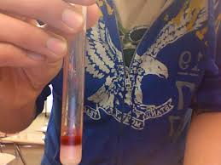
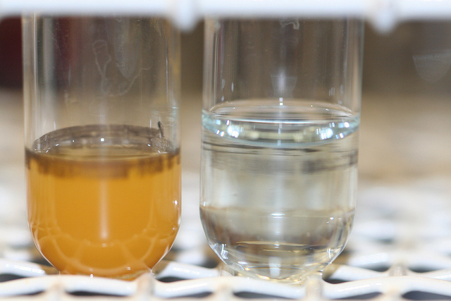
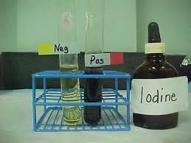
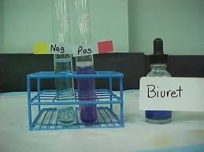
Lipids, Starches, Sugars, and Proteins
Lipids- Sudan III stains lipids
Starches– iodine turns blue black
Sugar- benedicts turns colors when heated
Proteins- Biuret turns purple

